Slide 1
Maven Retail Analytics
End-to-End Data Analysis Project
SQL Server · Power BI · DAX · Figma
Built by Manal Thabet — Route Diploma

Slide 2
Project Overview
What this project covers — 8 phases from raw data to business insights
Phase | Name | Tool
1 | Data Understanding & Planning | Excel / CSV
2 | SQL Database Design & Loading | SQL Server
3 | SQL Analysis & Business Queries | SQL Server
4 | SQL Views & Data Preparation | SQL Server
5 | Power BI Data Modeling | Power BI
6 | DAX Measures & KPIs | Power BI
7 | Dashboard Design | Figma + Power BI
8 | Business Insights | Power BI
This project is an end-to-end data analysis for a retail company operating stores across the USA, Mexico, and Canada. The goal was to build a single trusted data model, answer 12 business questions through SQL, and deliver an interactive Power BI dashboard with clear KPIs and actionable recommendations.
Data source: 269K+ transactions · 2 years (1997–1998) · 3 countries

Slide 3
Phase 1 & 2 — Data Planning & SQL Database
Understanding the data, designing the Star Schema, and building the database
Phase 1 — Data Understanding & Planning
Tables Created
The first step was reviewing all CSV files to understand what data was available. I identified the fact tables (Sales and Returns) and the dimension tables (Products, Customers, Stores, Region, Calendar). I then formulated 12 business questions that management needed answers to and planned a Star Schema data model.
Table | Type | Key columns
Region | Dimension | region_id (PK)
Products | Dimension | product_id (PK)
Customers | Dimension | customer_id (PK)
Stores | Dimension | store_id (PK), region_id (FK)
Calendar | Dimension | date (PK)
Sales | Fact | product_id, customer_id, store_id (FKs)
Returns | Fact | product_id, store_id (FKs)
Phase 2 — SQL Database Design & Loading
I created the database RETAIL_Graduation_Project in SQL Server and built 6 tables with proper data types, Primary Keys, and Foreign Keys. Data from two years of CSV files (Sales 1997 and Sales 1998) was loaded and merged. A Calendar table was created using a WHILE loop covering 1990 to 2025.

Slide 4
Phase 3 — SQL Analysis & Business Queries
Answering 12 business questions using JOINs, aggregations, and CTEs
Using SQL Server, I answered all 12 business questions defined in Phase 1. The queries used techniques including multi-table JOINs, GROUP BY aggregations, TOP N filtering, and a Common Table Expression (CTE) for the Year-over-Year growth calculation.
# | Business Question | SQL Technique
Q1 | Total transactions & quantity sold | COUNT(*), SUM()
Q2 | Top 5 best-selling products | JOIN, GROUP BY, TOP 5
Q3 | Total revenue by country | JOIN Stores, GROUP BY country
Q4 | Revenue by region | JOIN Region, GROUP BY region
Q5 | Monthly revenue 1997 vs 1998 | YEAR(), MONTH(), GROUP BY
Q6 | Year-over-Year growth % | CTE + SELF JOIN
Q7 | Total return rate % | CTEs + Aggregation (Returns Qty / Sales Qty)
Q8 | Products with highest return rate | JOIN Returns, GROUP BY product
Q9 | Revenue by customer occupation | JOIN Customers, GROUP BY occupation
Q10 | Top 10 customers by revenue | JOIN Customers, TOP 10, ORDER BY
Q11 | Average order value | SUM(qty * price) / COUNT(*)
Q12 | Which region underperforms? | GROUP BY region, ORDER BY revenue ASC

Slide 5
Phase 4 & 5 — SQL Views & Power BI Data Model
Preparing analysis-ready data and building the semantic model
Phase 4 — SQL View Created
Phase 5 — Power BI Data Model
To make the data easy to use in Power BI, I created a SQL View called View_Final_Analysis. This view joins Sales, Products, Stores, Region, and Customers into one clean, analysis-ready table that Power BI can connect to directly without complex transformations.
Power BI was connected to SQL Server and all fact and dimension tables were loaded. Relationships were set between tables to build a clean Star Schema semantic model. This model powers all visuals and DAX calculations across the dashboard.
View_Final_Analysis columns:
Relationships built:
Column | Source Table
transaction_date | Sales
quantity | Sales
product_name | Products
product_retail_price | Products
store_name | Stores
sales_region | Region
customer_city | Customers
From (Fact) | To (Dimension) | Key
Sales | Products | product_id
Sales | Customers | customer_id
Sales | Stores | store_id
Sales | Calendar | transaction_date
Stores | Region | region_id
Returns | Products | product_id
Returns | Stores | store_id

Slide 6
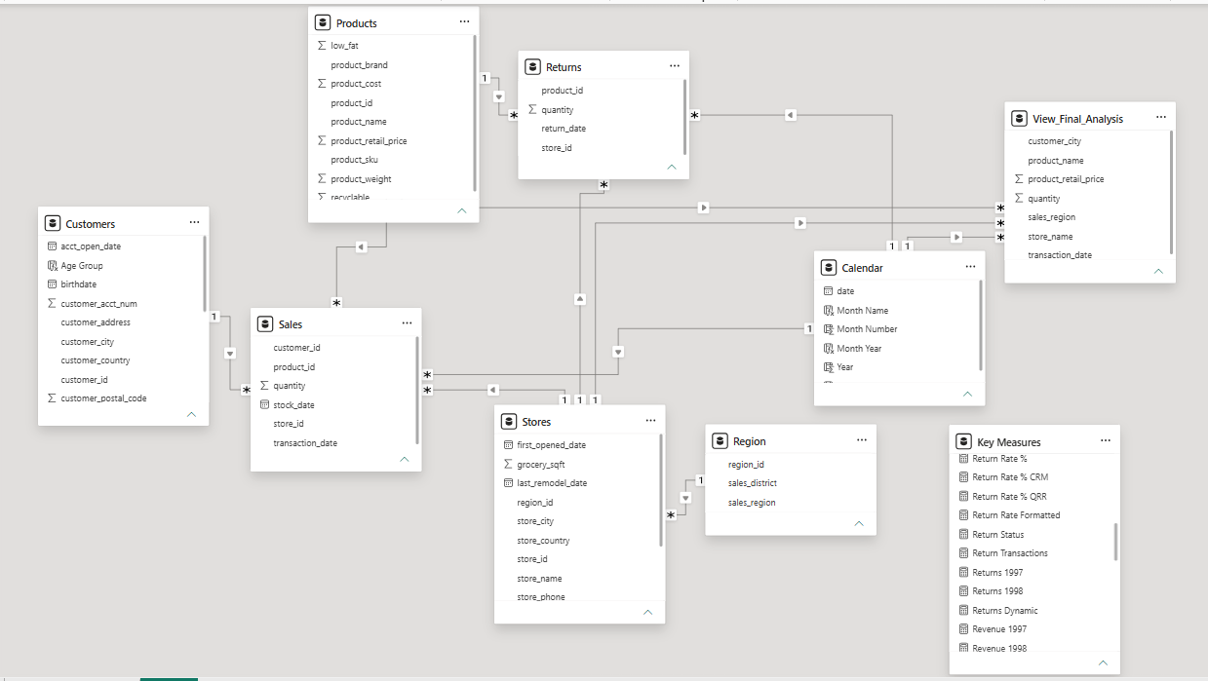
Phase 4 & 5 — SQL Views & Power BI Data Model
The Semantic Data Model

Slide 7
Phase 6 — DAX Measures & KPIs
7 business metrics built using DAX in Power BI
Seven DAX measures were created to power the KPI cards and calculations across the dashboard. Each measure was written to be reusable — other calculations reference them using the [Measure Name] syntax.
# | KPI Name | DAX Formula | Result
1 | Total Revenue | SUMX(Sales, Sales[quantity] * RELATED(Products[product_retail_price])) | $1.76M
2 | Total Transactions | COUNTROWS(Sales) | 270K
3 | Average Order Value | DIVIDE([Total Sales], [Total Orders], 0) | $1,765
4 | Total Returns | SUM(Returns[quantity]) | 7,087
5 | Return Rate % | DIVIDE([Total Returns], [Total Orders], 0) | 1.0%
6 | Year-over-Year Growth | DIVIDE([Total Sales] - [Sales LY], [Sales LY], BLANK()) | +112.2%
7 | Month-over-Month Growth | DIVIDE([Total Sales] - [Sales PM], [Sales PM], BLANK()) | Tracked

Slide 8
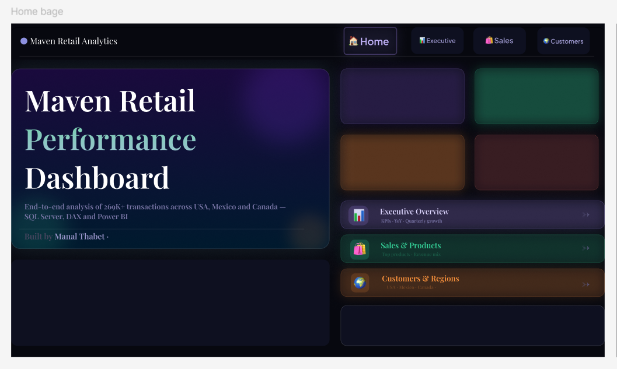
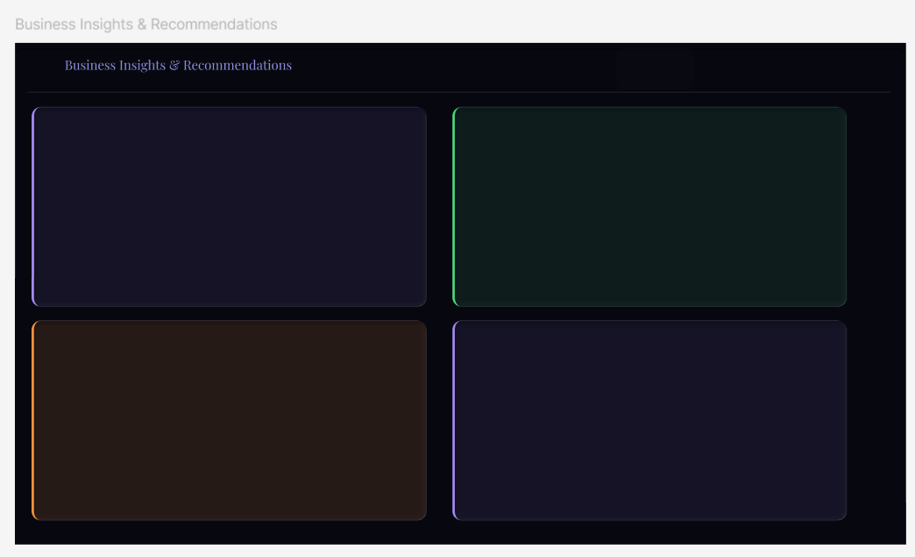
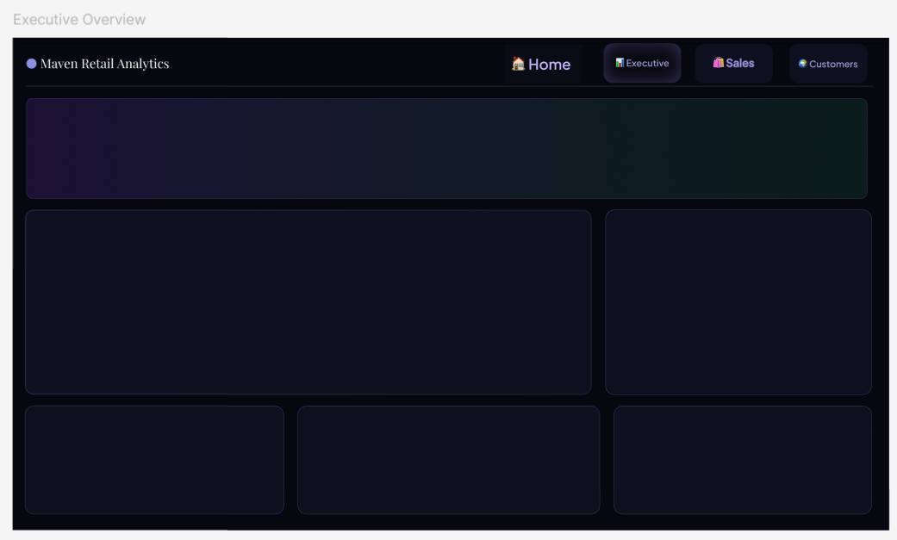
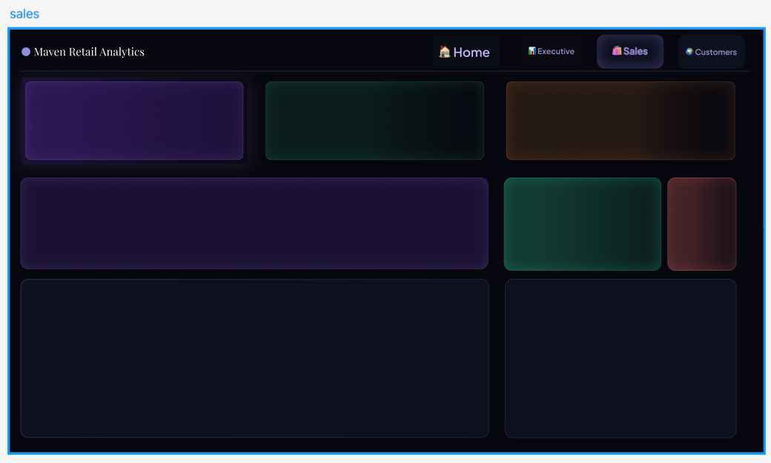
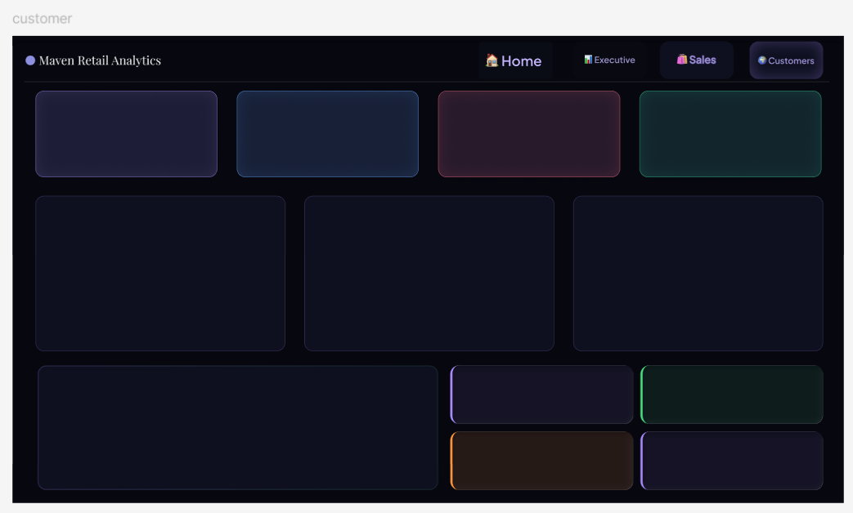
Phase 7 — Figma Dashboard Professional Frame Design
Dashboards Using Figma

Slide 9
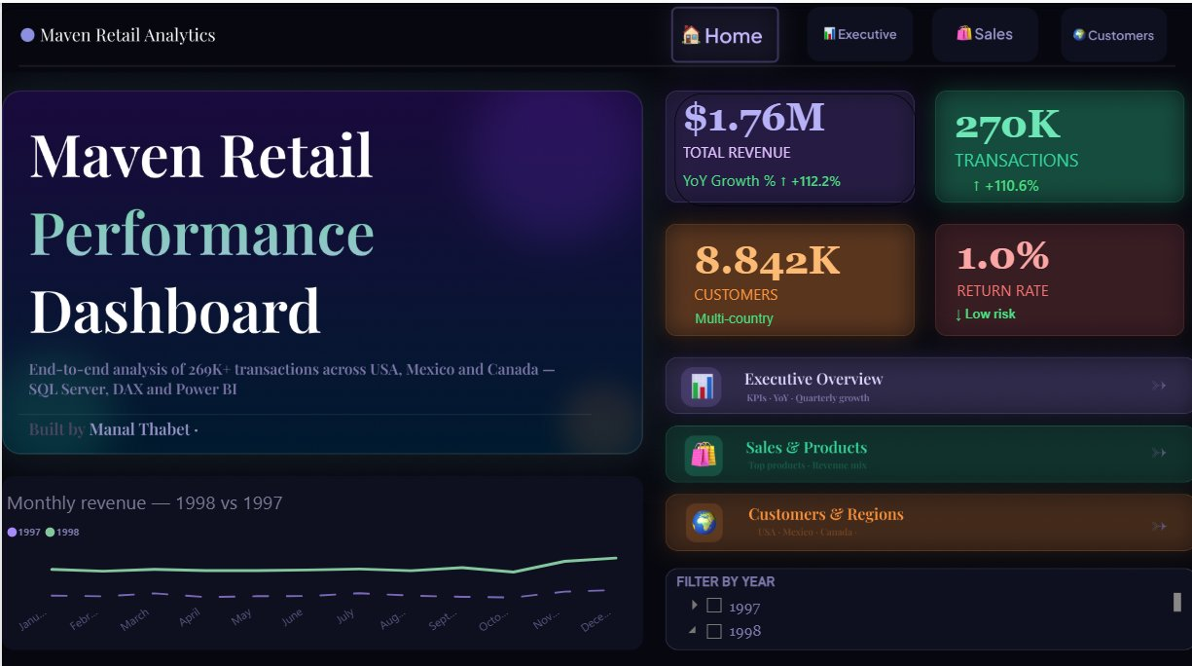
Phase 7 — Dashboard: Home Page
Navigation hub with live KPI cards and monthly revenue trend
The Home page serves as the navigation hub. It displays four KPI summary cards at the top right showing Total Revenue ($1.76M), Total Transactions (270K), Customers (8,842), and Return Rate (1.0%). A monthly revenue line chart compares 1997 vs 1998 performance, and a year filter allows users to drill into a specific year. Navigation buttons at the top link to Executive, Sales, and Customers pages.

Slide 10
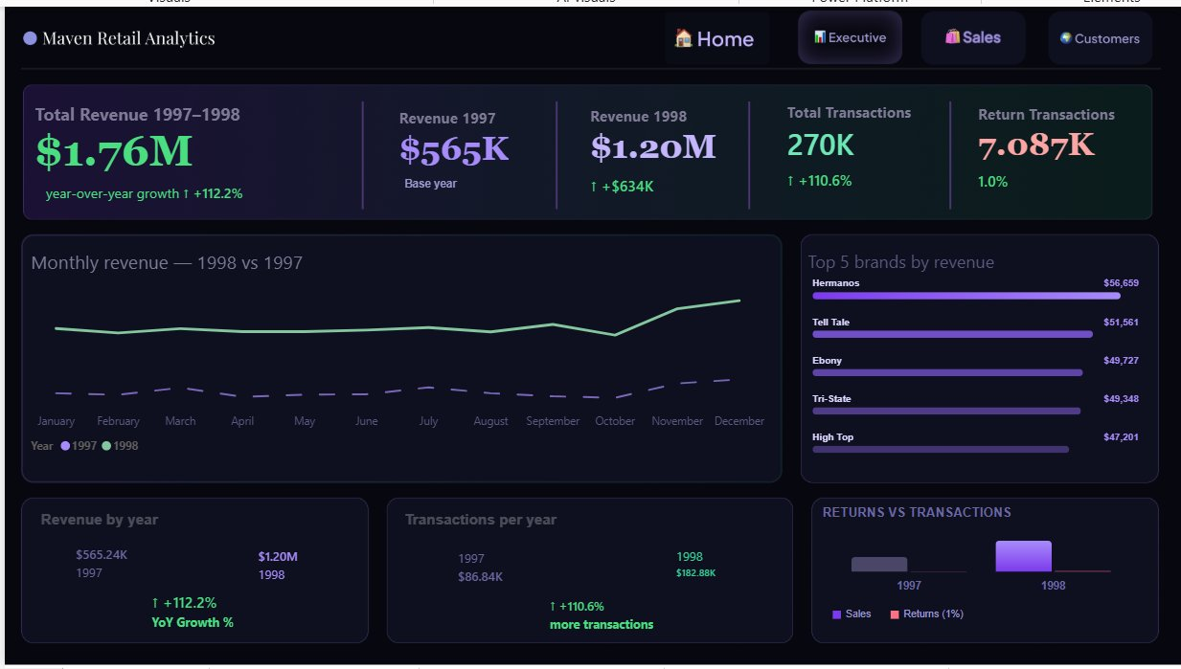
Dashboard: Executive Overview
Revenue totals, year-over-year growth, top brands, and returns analysis
The Executive page shows the full financial picture. The top KPI bar displays Total Revenue 1997–1998 ($1.76M), Revenue 1997 ($565K) vs Revenue 1998 ($1.20M), Total Transactions (270K), and Return Transactions (7,087 at 1.0%). A monthly revenue line chart overlays both years. The top 5 brands by revenue are shown as a bar chart (Hermanos leads at $56,659). The bottom section compares Revenue by Year and Transactions per Year side by side, and a Returns vs Transactions visual confirms the low 1% return rate.

Slide 11
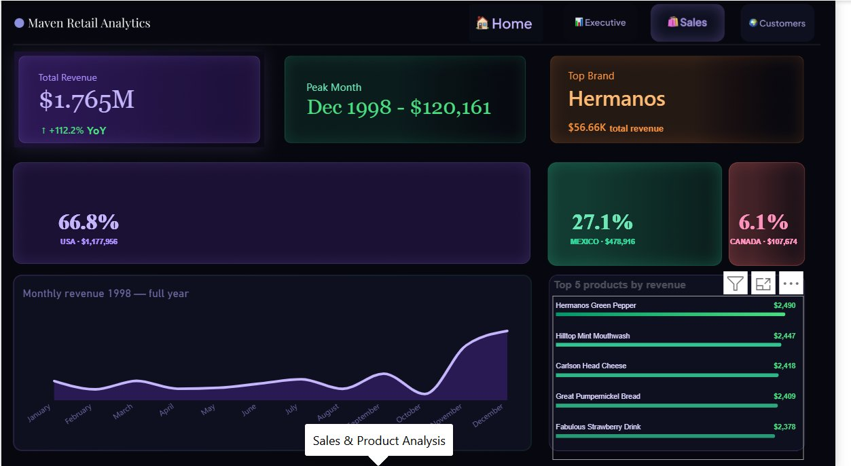
Dashboard: Sales & Product Analysis
Revenue breakdown by country, peak month, top brand, and top products
The Sales page breaks down performance by product and geography. The top KPI cards highlight: Total Revenue ($1.765M, +112.2% YoY), Peak Month (December 1998 at $120,161), and Top Brand (Hermanos at $56.66K). Three country cards show revenue share — USA 66.8% ($1.18M), Mexico 27.1% ($479K), Canada 6.1% ($108K). The bottom left shows the full-year 1998 monthly revenue trend (an area chart with strong Q4 growth), and the bottom right lists the Top 5 products by revenue — all within a narrow $2,378–$2,490 range.

Slide 12
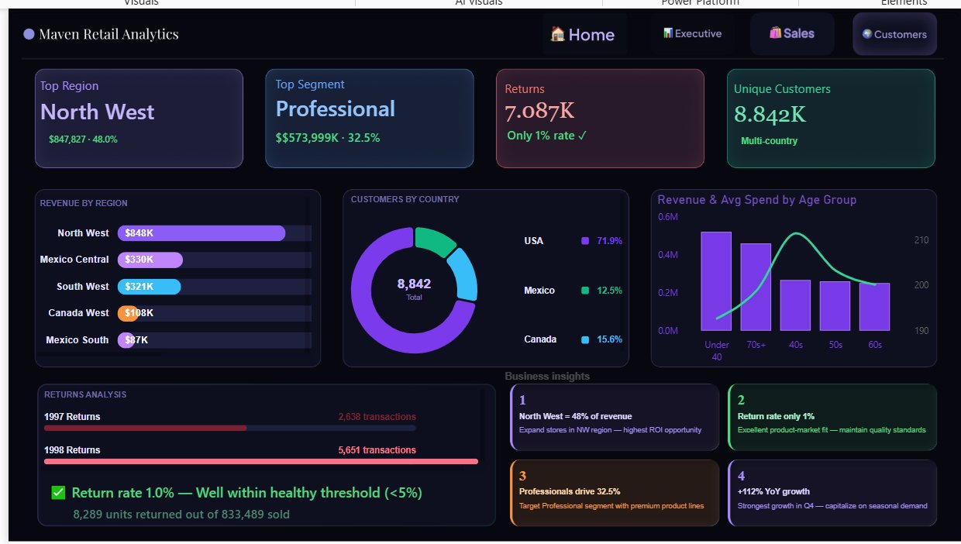
Dashboard: Customers & Regional Insights
Top region, customer segments, returns analysis, and business insights
The Customers page combines regional performance, customer demographics, and the Phase 8 business insights. KPI cards show: Top Region (North West, $847,827 — 48.0%), Top Segment (Professional, $574K — 32.5%), Returns (7,087 at only 1%), and Unique Customers (8,842 across 3 countries). Visuals include: Revenue by Region bar chart, Customers by Country donut (USA 71.9%, Canada 15.6%, Mexico 12.5%), Revenue & Avg Spend by Age Group, and a Returns Analysis section showing 1997 vs 1998 return volumes. The Business Insights panel at the bottom summarizes the 4 key findings directly on the dashboard.

Slide 13
Phase 8 — Business Insights & Recommendations
4 data-backed findings answering the questions from the project brief
The final phase translates dashboard numbers into decisions. Each insight is backed by specific data from the dashboard.
01 What drives sales growth?
02 Which products or regions underperform?
Revenue doubled from $565K (1997) to $1.20M (1998) — a +112.2% YoY increase. The strongest growth occurred in Q4, with November and December 1998 combined reaching $233K. This points to strong seasonal demand patterns.
North West region generates 48% of all revenue ($847,827), while Canada West ($108K) and Mexico South ($87K) significantly lag behind. No single product drastically underperforms — the top 5 products are tightly clustered between $2,378 and $2,490.
→ Capitalize on Q4 demand with targeted promotions and increased inventory in October–December.
→ Expand store presence and marketing in the North West. Review pricing strategy in Canada West and Mexico South.
03 What is the impact of returns?
04 Where should management focus next quarter?
8,289 units were returned out of 833,489 sold — a return rate of just 1.0%, well below the 5% industry benchmark. Returns grew proportionally from 2,638 (1997) to 5,651 (1998), tracking with the overall sales increase.
The Professional occupation segment contributes 32.5% of revenue ($574K), making it the highest-value customer group. The Under-40 age group has the highest average spend per customer. North West region offers the highest return on investment for expansion.
→ Maintain current supplier quality standards to preserve this strong product-market fit.
→ Launch B2B loyalty programs targeting Professionals. Focus Q4 campaigns on under-40 customers in North West.

Slide 14
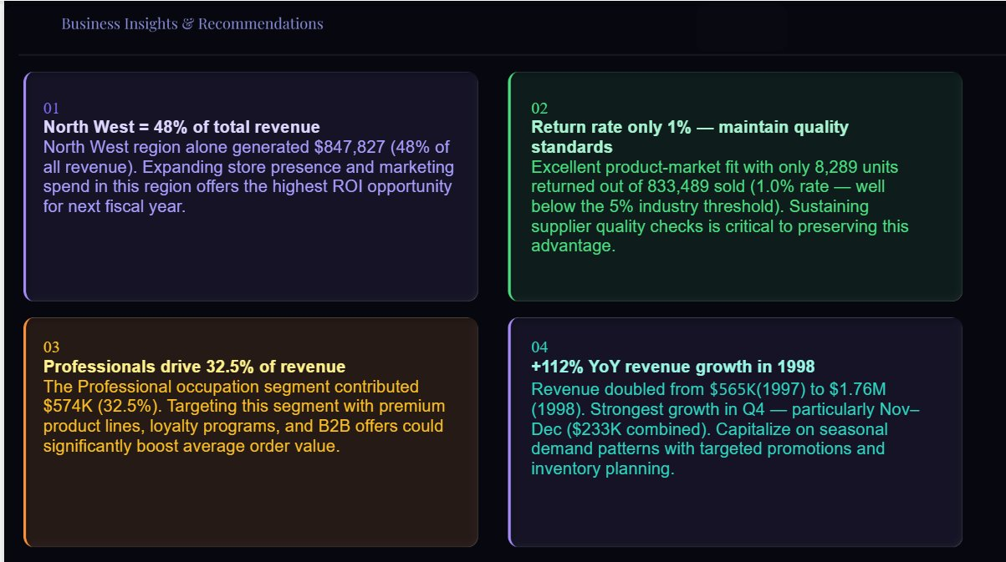
Business Insights — Dashboard View
The Business Insights & Recommendations page from Power BI
This dedicated page in the Power BI dashboard presents all four insights visually, each in a colored card with the finding and the recommendation clearly stated for management.

Slide 15
Project Summary
What | Result
Database | RETAIL_Graduation_Project — 6 tables, PKs & FKs, 2 years of data merged
SQL Queries | 12 business questions answered using JOINs, GROUP BY, CTEs, TOP N
SQL View | View_Final_Analysis — 5 tables joined, analysis-ready for Power BI
DAX KPIs | 7 measures: Total Sales, Orders, AOV, Returns, Rate%, YoY, MoM
Dashboard | 4 pages: Home, Executive, Sales & Products, Customers & Regions
Total Revenue | $1.76M across 1997–1998 — +112.2% Year-over-Year growth
Transactions | 270K transactions — +110.6% vs 1997
Customers | 8,842 unique customers across USA, Mexico, and Canada
Return Rate | 1.0% — well below the 5% industry threshold
Top Region | North West — 48% of total revenue ($847,827)
Top Segment | Professional occupation — 32.5% of revenue ($574K)
Built by Manal Thabet · Route Diploma — Data Analysis Track

